Slide 1
CHAPTER -1
INFORMATION SYSTEM

Slide 2
MEANING OF IMFORMATION SYSTEM (IS)
An Information System (IS) is a set of interrelated components that collect, process, store and distribute information to support decision making and control in an organization.
Vast majority of computerized IS relies on data warehouse and database management system(DBMS) software to manage the storage and retrieval of information in the system.

Slide 3
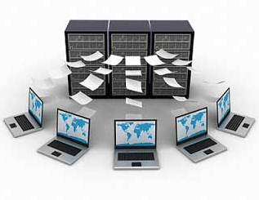
MEANING OF IMFORMATION SYSTEM (IS)
IS accept data from their environment and manipulate data to produce information that is used to solve a problem or address a business need.
In earlier days, majority of information system were manual systems.
These days, IS is mostly computerized, software intensive systems.

Slide 4
MANUAL vs COMPUTERIZED SYSTEM
DISADVANTAGES OF MANUAL SYSTEM:
Time Taking Process
Difficult to handle
More possibilities of errors
ADVANTAGES OF COMPUTERIZED SYSTEM
Time saving
Proper management
Easy to handle
Less possibilities of errors

Slide 5
Critical Characteristics Of Information
The value of information comes from the characteristics it possesses.
Availability
Accuracy
Authenticity
Confidentiality
Integrity
Utility
Possession

Slide 6
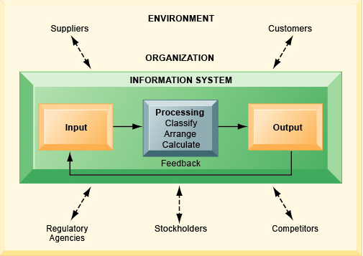
FUNCTIONS OF IMFORMATION SYSTEM (IS)
Major Functions:
input
Storage
Processing
Control
Output
Examples:
In Finance – Financial
Management Information
System
In Marketing and Sales
Area– CRM (Customer
relationship management).
Fig 2: Functions of Information System

Slide 7
IMPORTANCE OF IMFORMATION SYSTEM (IS)
Operations Management: All operations are done efficiently .
Decision-Making: Help to make profitable decisions for any organization.
Record-Keeping: All data is saved and kept for any reference.
Main purpose: To turn raw data into useful information that can be used for decision making in an organization.

Slide 8
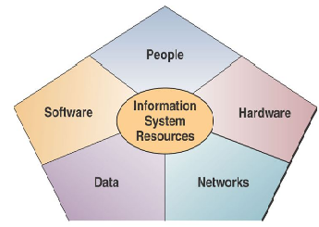
COMPONENTS OF INFORMATION SYSTEM (IS)
An information system is essentially made up of five components
hardware
software
Database
network
people.

Slide 9
MAJOR ROLES OF INFORMATION SYSTEM (IS)
Three major roles of the business applications of information systems include: • Support Business Processes – involves dealing with information systems that support the business processes and operations in a business. • Support Decision Making – help decision makers to make better decisions and attempt to gain a competitive advantage. • Support Competitive Advantage – help decision makers to gain a strategic advantage over competitors requires innovative use of information technology.

Slide 10
TYPES OF INFORMATION SYSTEM( IS)
There are 5 Types of Information Systems as mentioned below:
Transaction Processing Systems
Management Information Systems(MIS)
Decision Support Systems
Expert Systems and Neutral Networks
Information Systems in Organizations

Slide 11
WHAT IS SECURITY?
The quality or state of being secure--to be free from danger”
A successful organization should have multiple layers of security in place:
Physical security
Personal security
Operations security
Communications security
Network security

Slide 12
What Is Information Security?
The protection of information and its critical elements, including the systems and hardware that use, store, and transmit that information.
Information security (InfoSec) is designed to protect the confidentiality, integrity and availability(CIA) of computer system data from those with malicious intentions.
For example, a message could be modified during transmission by someone intercepting it before it reaches the intended recipient. Good cryptography tools can help mitigate this security threat.

Slide 13
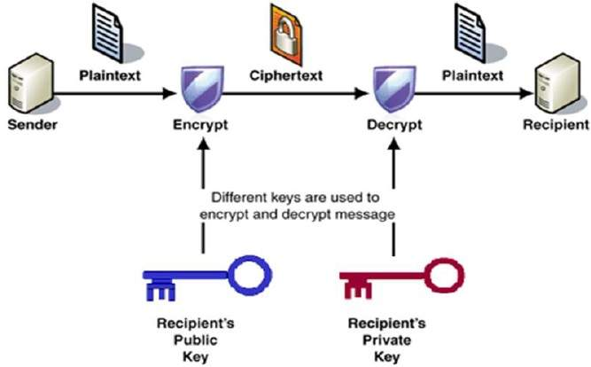
ENCRYPTION

Slide 14
CIA Triangle
The C.I.A. triangle was the standard based on confidentiality, integrity, and availability.
Confidentiality: Access must be restricted to authorized users only.
Example: ID and passwords to authenticate authorized users.
Integrity: maintaining the consistency, accuracy, and trustworthiness of data.
Example: Checksums for the verification of integrity.
Availability: Should be available to authorized users.

Slide 15
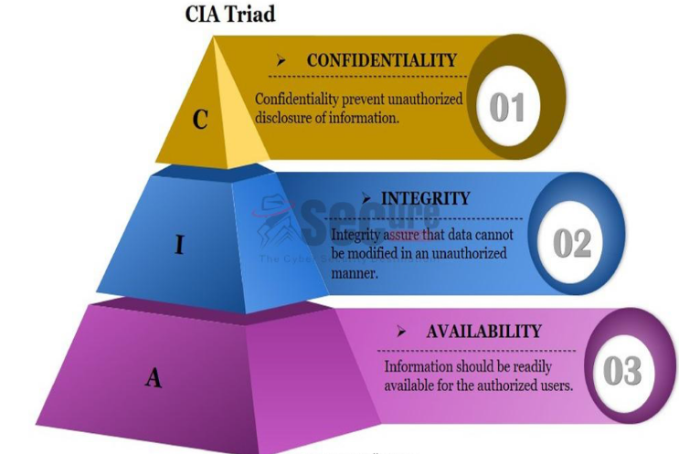
CIA Triangle

Slide 16
THREAT
A threat is a possible danger that might exploit a vulnerability to breach security and therefore cause possible harm.
A threat can be either “intentional" (i.e. hacking: an individual cracker or a criminal organization) or “accidental" (e.g. the possibility of a computer malfunctioning, or the possibility of a natural disaster such as an earthquake, a fire)or otherwise a circumstance, capability, action, or event.

Slide 17
THREATS
Asset: something of value to the organization
Actor: Who or what may violate the security requirements of an asset.
Motive: Indication of whether the actor’s intension are deliberate or accidental.
Access: How the asset will be accessed.
Five types of physical and logical assets:
Information
Software
Hardware
People
Systems

Slide 18
Asset Types and their values
Physical Assets (hardware, cars)
Logical Assets (purchased softwares, OS, DB)
Intangible Assets (business reputation, confidence)
Human Assets (human skills, knowledge)

Slide 19
IMPORTANT TERMS
Security gaps are points at which security is missing, and thus system is vulnerable.
Vulnerability is state in which an object can potentially be affected by a force or another object or even a situation but not necessarily is or will be.
Threat is defined as security risk that has high possibility of becoming a system breach.
RISK:The potential for loss, damage or destruction of an asset as a result of a threat exploiting a vulnerability.
SYSTEM BREACH:A security breach is any incident that results in unauthorized access of data, applications, services, networks and/or devices by bypassing their underlying security mechanisms.

Slide 20
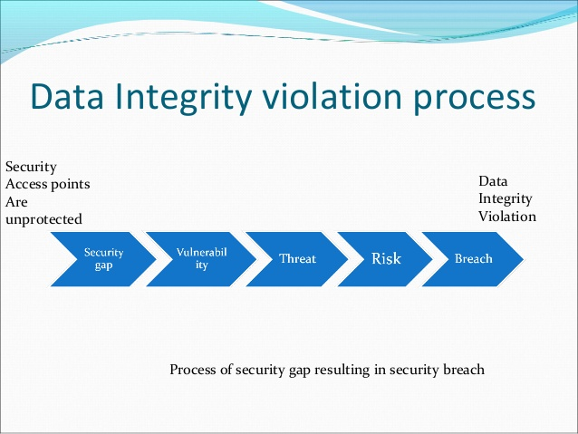
Data Integrity violation process

Slide 21
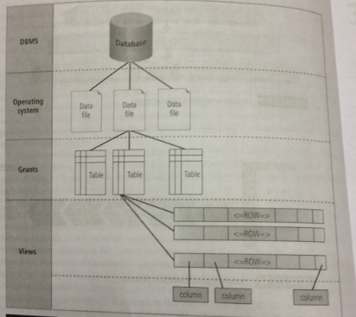
Database Security Levels

Slide 22
Database Security Levels
VIEW database object is stored query that returns columns and rows from selected tables.
Data provided by view object is protected by database system functionality that allows schema owners to grant or revoke privileges.
Data files in which data resides are protected by database and that protection is enforced by OS file permissions.
Finally database is secured by DBMS (through accounts and password mechanism, privileges, permissions to few)

Slide 23
Menaces to Databases
Security Vulnerability
Security Threat (security violation that can happen any time because of security vulnerability)
Security Risk (A known security gap that company intentionally leaves open)

Slide 24
Types of Vulnerabilities
Installation and configuration (results from default installation/configuration which is known publicly and we don’t enforce any security measures)
User mistakes (due to carelessness in implementing procedures)
Software (found in commercial softwares, patches not applied)
Design and implementation (due to improper software analysis, design as well as coding deficiencies)

Slide 25
Types of Threats
People (people intentionally/unitentionally inflict damage, e.g. hackers,terrorists)
Malicious code (software code that is intentionally written to damage the components, e.g. viruses)
Natural disasters
Technological disasters (malfunction in equipment, e.g. network failure, hardware failure)

Slide 26
Types of Risks
People (loss of people who are vital components of DB, e.g. due to resignation)
Hardware (results in hardware unavailability, down due to failure, malfunction)
Data (data loss, corruption)
Confidence (loss of public confidence in data produced by company)

Slide 27
COMMON THREATS TO INFOSEC
Spam
Spam occurs when you receive several unsolicited emails that will phish for your information by tricking you into following links.

Slide 28
COMMON THREATS TO INFOSEC
Phishing
Phishing in unfortunately very easy to execute. It consists of fake emails or messages that look exactly like emails from legitimate companies. You are deluded into thinking it’s the legitimate company and you may enter your personal and financial information.
Ransomware
a type of malicious software designed to block access to a computer system until a sum of money is paid.

Slide 29
COMMON THREATS TO INFOSEC
Computer worm
A worm is a specific type of virus. Unlike a typical virus, it's goal isn't to alter system files, but to replicate so many times that it consumes hard disk space or memory. Worm victims will notice their computers running slower or crashing
Spyware / Trojan Horse
A Trojan Horse is a malicious program that looks like a legitimate software. While installed on your computer it runs automatically and will spy on your system, or delete your files.

Slide 30
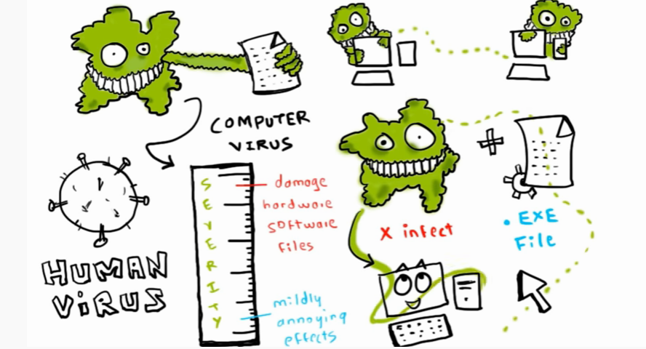

Slide 31
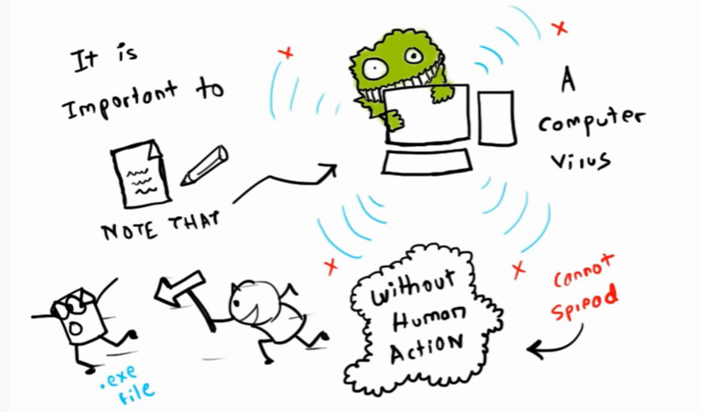

Slide 32
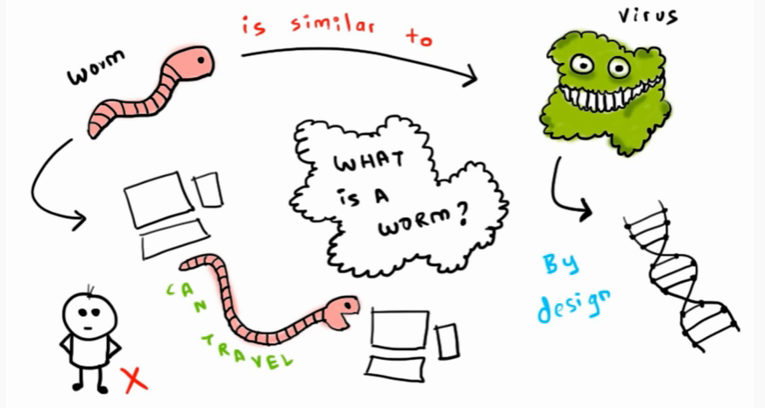

Slide 33
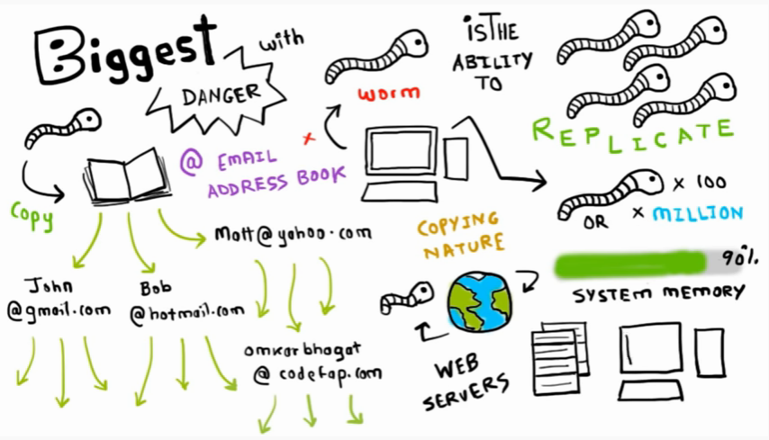

Slide 34
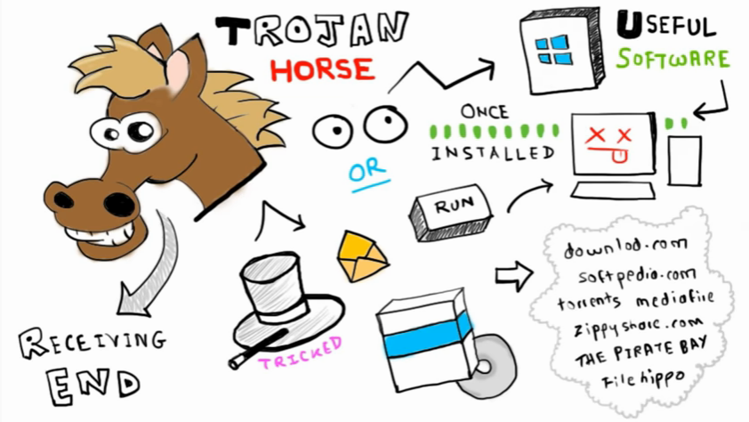

Slide 35
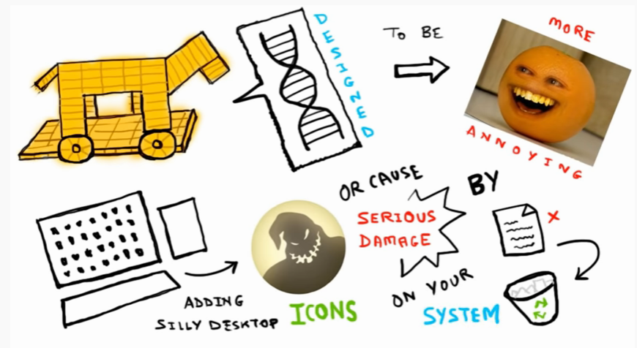

Slide 36
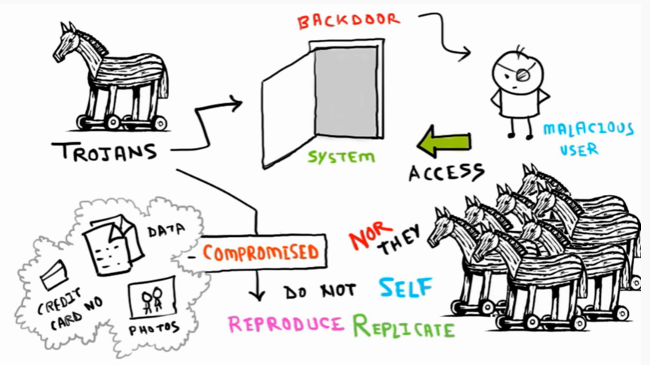

Slide 37
COMMON THREATS TO INFOSEC
Distributed denial-of-service attack
The attack strategy is to contact a specific website or server over and over again. It increases the volume of traffic and shuts down the website / server. The malicious user usually uses a network of zombie computers.
Network of zombie computers
This is a way to execute several security threats. The malicious user takes control of several computers and controls them remotely.

Slide 38
COMMON THREATS TO INFOSEC
Malware
This is the common name given to several security threats that infiltrate and damage your computer.
Virus
A virus is always hidden in a legitimate software or website and infects your computer as well as the computers of everyone in your contact list.

Slide 39
PROTECTING INFORMATION SECURITY
Preventive Controls: Prevent an error or an attack from taking effect.
Detective Controls: Detect a violation.
Corrective Controls: Detect and correct an exceptional situation.

Slide 40
SYSTEM DEVELOPMENT LIFE CYCLE
It is a process of creating information systems, and the models and methodologies that people use to develop these systems.
The SDLC process was designed to ensure that end-state solutions meet user requirements in support of business strategic goals and objectives.
SDLC is used to develop, maintain and replace Information System

Slide 41
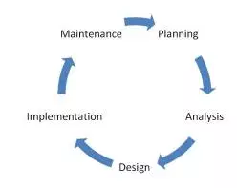
SYSTEM DEVELOPMENT LIFE CYCLE
There are main 5 steps in SDLC.
PLANNING
ANALYSIS
DESIGN
IMPLEMENTATION
MAINTENANCE

Slide 42
SYSTEM DEVELOPMENT LIFE CYCLE
PLANNING
What is the problem the system is being developed to solve?
The objectives, constraints, and scope of the project are specified
A preliminary cost/benefit analysis is developed
A feasibility analysis is performed to assesses the economic, technical, and behavioral feasibilities of the process.

Slide 43
SYSTEM DEVELOPMENT LIFE CYCLE
ANALYSIS
Consists primarily of
assessments of the organization
the status of current systems
capability to support the proposed systems
Analysts begin to determine
what the new system is expected to do
how the new system will interact with existing systems
Ends with the documentation of the findings and a feasibility analysis update

Slide 44
SYSTEM DEVELOPMENT LIFE CYCLE
DESIGN
Based on business need, applications are selected capable of providing needed services
Based on applications needed, data support and structures capable of providing the needed inputs are identified
Finally, based on all of the above, select specific ways to implement the physical solution are chosen
At the end, another feasibility analysis is performed.

Slide 45
SYSTEM DEVELOPMENT LIFE CYCLE
IMPLEMENTATION
Components are ordered, received, assembled, and tested
Users are trained and documentation created
Users are then presented with the system for a performance review and acceptance test.
MAINTENANCE
Tasks necessary to support and modify the system for the remainder of its useful life
The life cycle continues until the process begins again from the investigation phase
When the current system can no longer support the mission of the organization, a new project is implemented.

